Slide 1
Providing Product-Service-Systems - The Long Way from a Product OEM towards an Original Solution Provider (OSP)
by
Christian Schnürmacher, Haygazun Hayka and Rainer Stark
Presenting Author: Christian Schnürmacher
Technische Universität Berlin
Berlin, Germany
Christian.schnuermacher@tu-berlin.de

Slide 2
Struktur
20 Minuten Präsentation
5 Minuten Diskussion

Slide 3
Agenda
Problem statement
Research methodology
Requirements for providing PSS
Requirement implementation
Conclusion and next steps

Slide 4
Problem statement

Slide 5
Problem Statement
Manufacturing companies which transform from Product OEM towards OSP fail to achieve high service revenues [1]
Comprehensive framework comprising all requirements for providing the PSS types proposed by Tukker [2] is missing
Holistic approach to help manufacturing firms implementing these requirements is missing

Slide 6
Research methodology

Slide 7
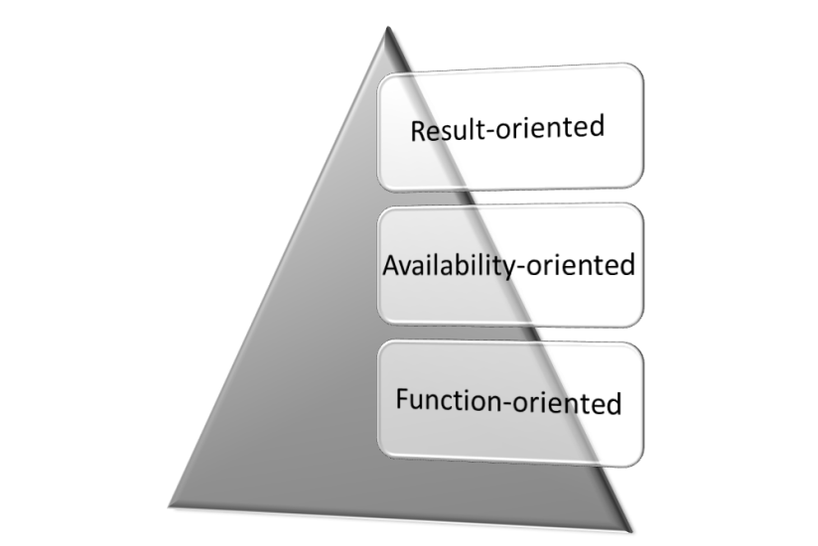
Research methodology
Literature research
Requirements for providing PSS
Implementation of an integrated product and service development process in the case company
Case company
Supplier of material handling, equipment and services
Has transformed over the last years from a product centered company towards a provider of products and services
More than 30 percent of the sales result from services
Study details
Document analysis
Five guideline based interviews
Details
4 findings were identified in an extensive literature research:
Gebauer H et. al. “Success factors for achieving high service revenues in manufacturing companies” [1]
Oliva R, Kallenberg R. “Managing the transition from products to services” [4]
Leseure M et. al. “Challenges in transforming manufacturing organisations into product-service providers” [5]
Elfving SW et. al. “At a Crossroads: Case Study Analysis of the Organizational Challenges within the Transformation Path to an IPS2” [6]
Case study

Slide 8
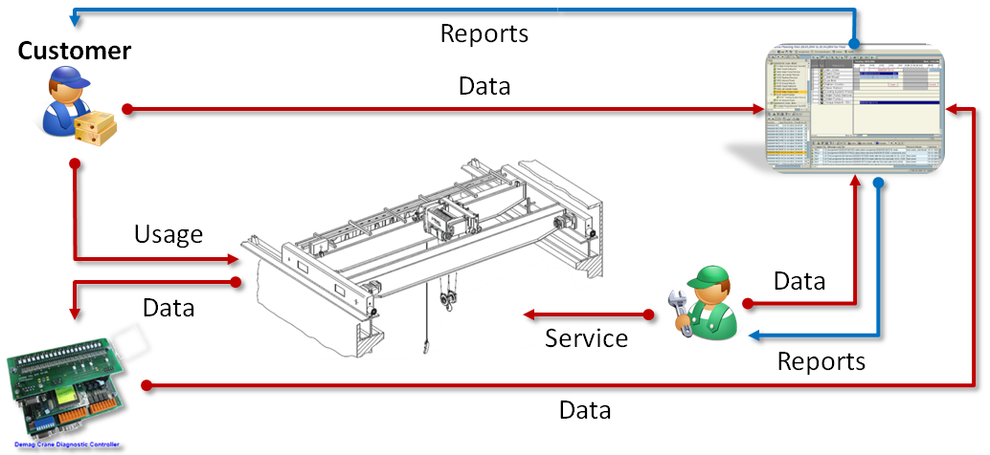
Development project in collaboration with the case company

Slide 9
Requirements for providing PSS

Slide 10
Requirements
Availability-oriented
Function-oriented
Result-oriented
Availability-oriented
Function-oriented
Result-oriented
Availability-oriented
Function-oriented
Result-oriented
Strategic requirements
Service strategy
Product- and service-oriented corporate culture
Separate service organization with profit and loss responsibility
Relationship marketing
Operational requirements
Integrated product and service development process
Service infrastructure
Availability-oriented
Function-oriented
Result-oriented
Higher qualification of employees
Data availability
Cost-effective monitoring tool for recording and wireless transfer of the operating data
Allowance for using operating data
Trustful relationship to the customer
Data analysis
Appropriate skills for analyzing the operating data
Sufficient resources for initial data analysis
Tool for automated data analysis
Data usage
Data security
Appropriate processes to use the operating data in integrated product and service development

Slide 11
Requirement implementation

Slide 12
Requirement implementation
Implementation of an integrated product and service development process in the case company
Analysis of existing development approaches
Definition of an development process and execution of a development project
Identification of challenges and definition of an implementation strategy

Slide 13
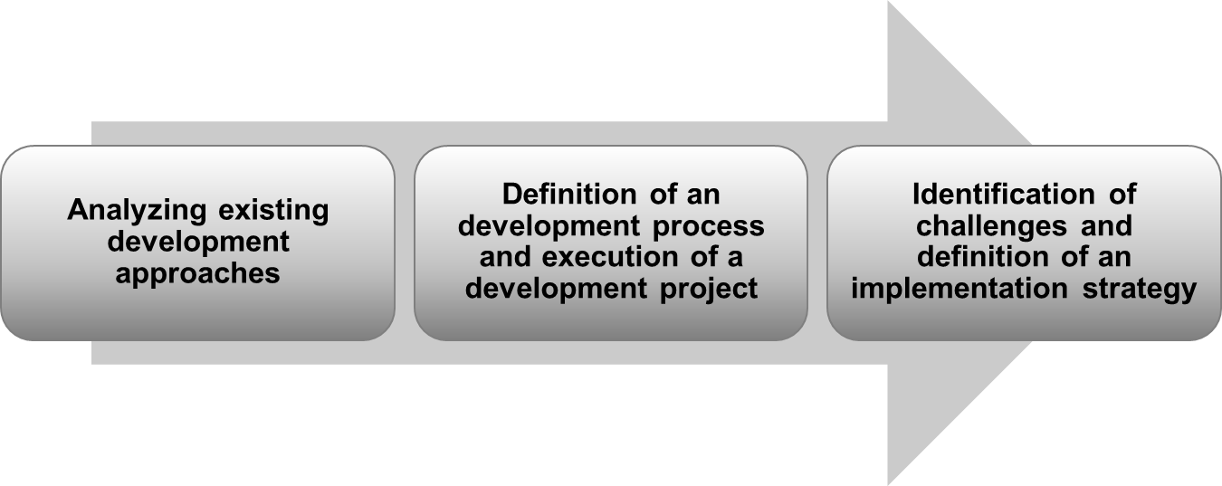
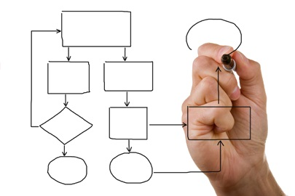
Existing development processes
Requirement implementation
Product development
Well-established stage gate process
Employees are familiar to a process oriented approach
Service development
No established development process
Development approach is highly dependent on the project manager

Slide 14
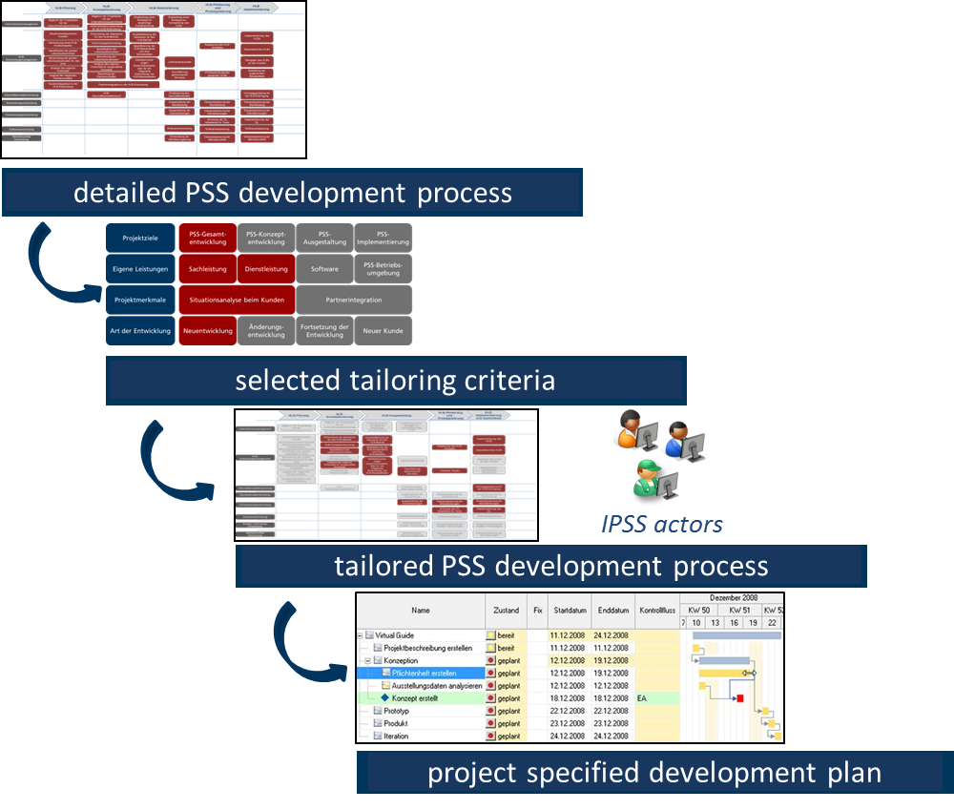
Process definition and project execution
Process is based on the method for operationalizing the PSS development process [3]
Defined process consists of 41 activity blocks with 170 activities and 41 milestones
Development project is still in progress

Slide 15
Challenges and implementation strategy
Challenges
Differences between old and new approach
Service employees are not used to a process oriented work
Implementation strategy
Integrate existing with new development process
Integrate participating employees in the design of the new process
Train service engineers
Consider methods from organizational change management
Quelle: www.myvirtual.biz

Slide 16
Conclusion and next steps

Slide 17
Conclusion and next steps
Requirements for providing PSS have been identified
Identified requirements need to be confirmed in further industrial projects
Challenges for implementing an integrated product and service development process have been identified and a implementation strategy has been formulated
Implementation strategies for other requirements need to be developed

Slide 18
Thank you for your attention!

Slide 19
appendix

Slide 20
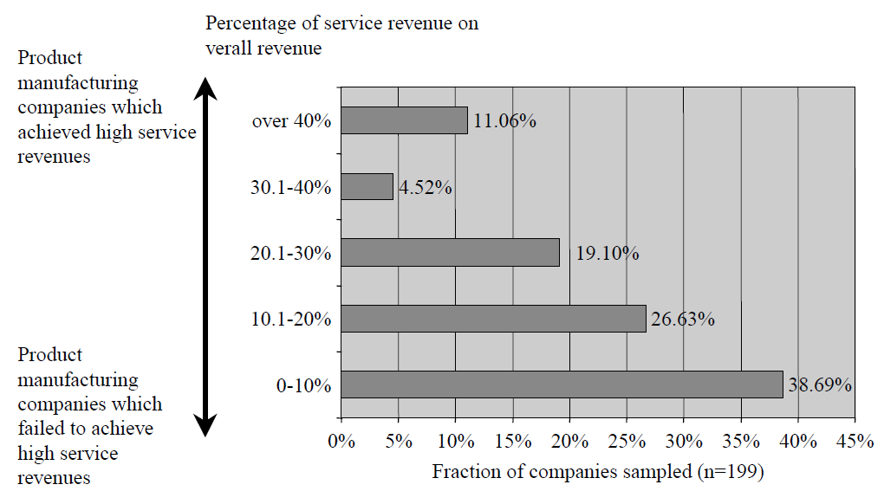
Service revenue in manufacturing companies
[1]

Slide 21
PSS types by Tukker [2]
Product-oriented services
Product, product related services as well as advice and consultancy
Use-oriented services
Product lease, product renting and product pooling
Result-oriented services
Activity management, pay per service unit and functional result

Slide 22
References
[1] Gebauer H, Friedli T, Fleisch E. Success factors for achieving high service revenues in manufacturing companies. Benchmarking: An International Journal 2006; 13:374-386.
[2] Tukker A. (2013): Product services for a resource-efficient and circular economy - a review. Journal of Cleaner Production 2013; In Press, Corrected Proof. Available online 7 December 2013.
[3] Nguyen H N, Exner K, Schnürmacher C, Stark R.: Operationalizing IPS² development process: A method for realizing IPS² developments based on Process-based project planning. In: ElMaraghy, H. (ed.): Product Services Systems and Value Creation. Proceedings of the 6th CIRP Conference on Industrial Product-Service Systems. Volume 16. Elsevier, 2014.
[4] Oliva R, Kallenberg R. Managing the transition from products to services. International Journal of Service Industry Management 2003; 14:160-172.
[5] Leseure M, Martinez V, Bastl M, Kingston J, Evans S. Challenges in transforming manufacturing organisations into product-service providers. Journal of Manufacturing Technology Management 2010; 21:449-469.
[6] Elfving SW, Washington N, Lienert A, Mänz K, Wilkens U. At a Crossroads: Case Study Analysis of the Organizational Challenges within the Transformation Path to an IPS2. Proceedings of 6th CIRP International Conference on Industrial Product-Service Systems, Windsor; 2014

